Slide 1
IES – Integrating the Energy System
<goes Europe>
IPE – Integrating the Publishing Environment – KickOff
Leiden (NL), Jan 18 – 19th, 2018
Georg Koch, Tiani „Spirit“ GmbH
www.iesaustria.at

Slide 2









IES – Partner
Sponsored by

Slide 3
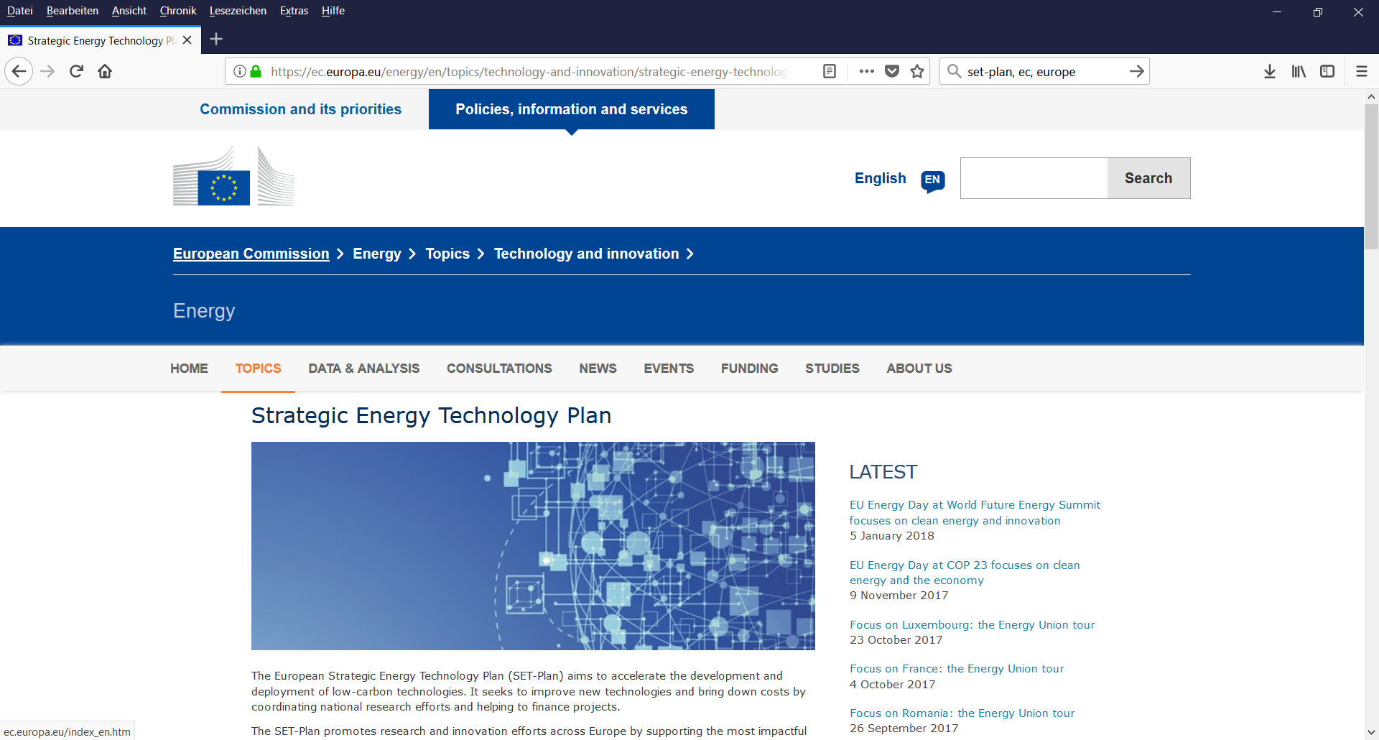
IES goes Europe → No1

Slide 4
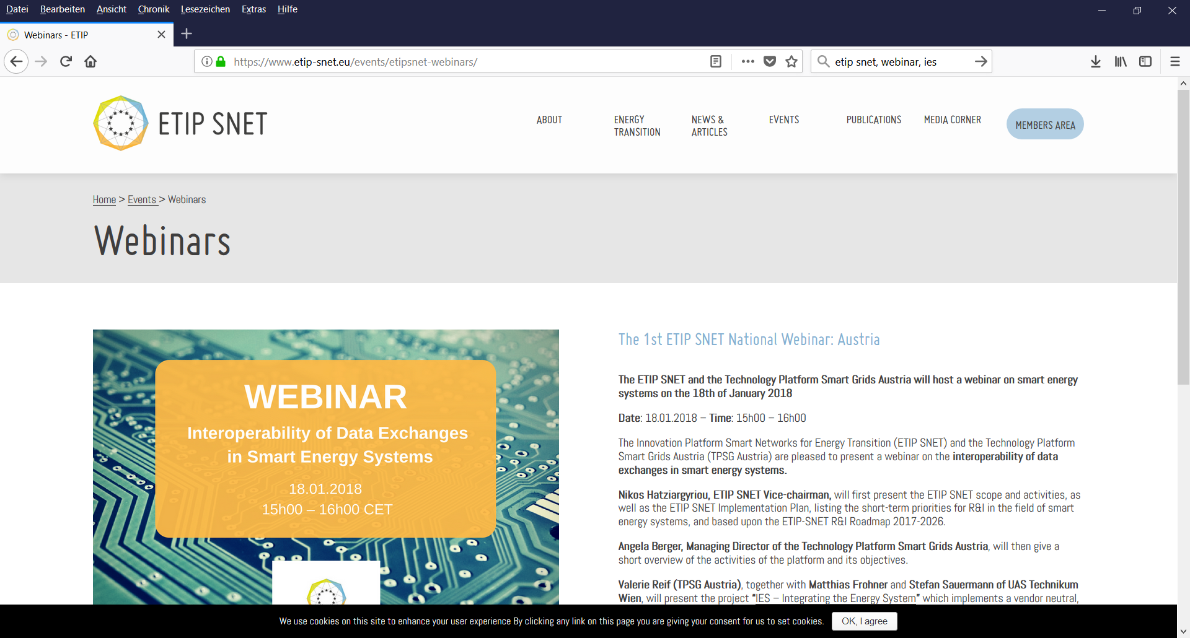
IES goes Europe → No2

Slide 5
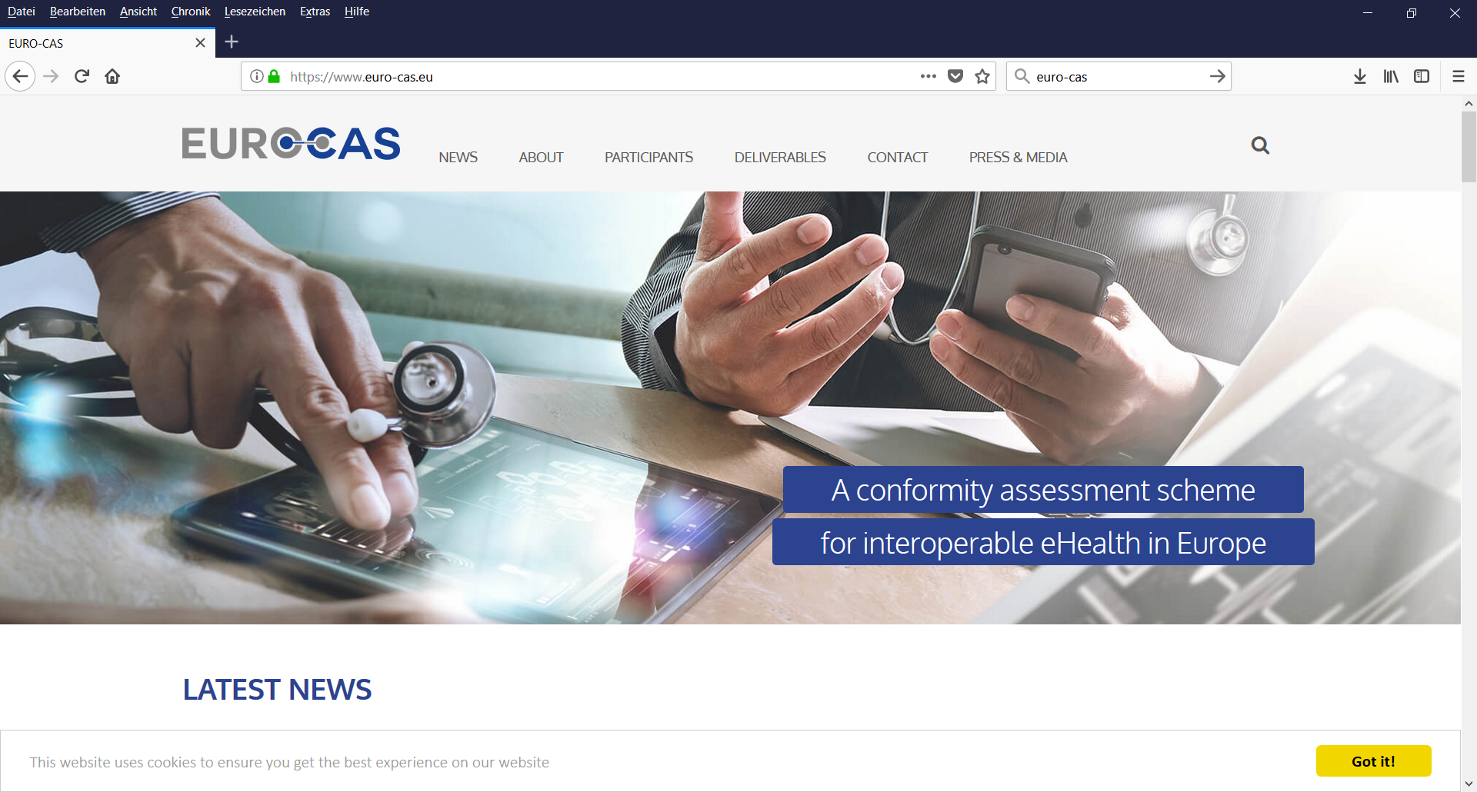
IES goes Europe → No3

Slide 6

IES goes Europe → No4
will be part of…

Slide 7
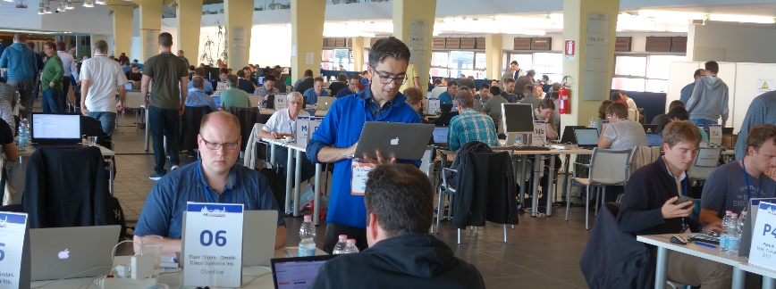
IES – Look-Out
Safe the Date!
Join at
IHE – Europe Connectathon 2018 April 16-20th, 2018
and
Weekonnect April 17-19th
in The Hague, Netherlands
See you
in
The Hague
☺
Thank
You!
Contact: Georg Koch, georg.koch@tiani-spirit.com

